Slide 1


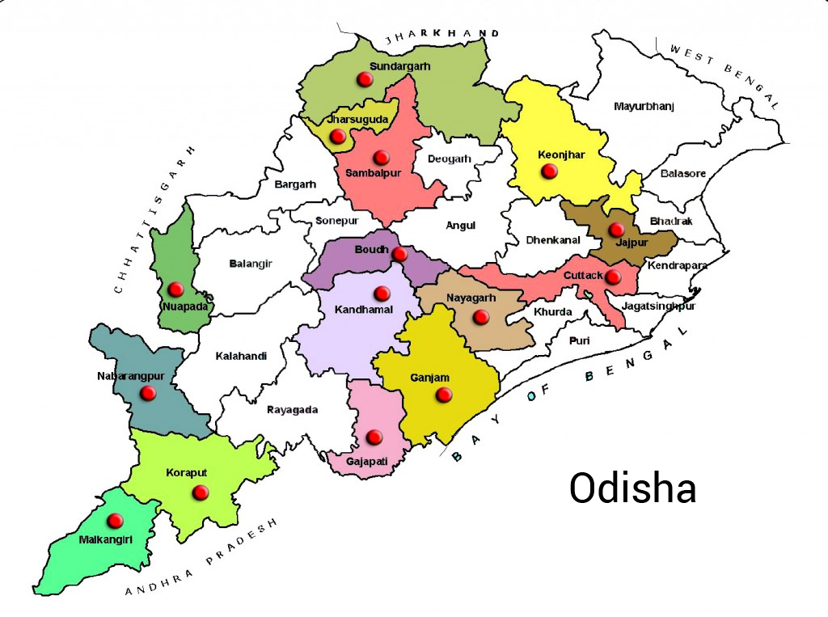
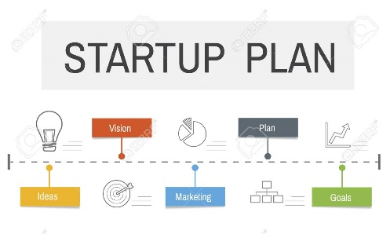


Y-1666
100 Business Opportunities in
Odisha (Orissa)
Business Ideas for Bhubaneswar, Cuttack, Rourkela, Brahmapur, Sambalpur, Puri, Balasore, Bhadrak, Baripada, Jharsuguda, Bargarh, Dhenkanal, Barbil, Angul, Jajpur
www.niir.org
www.entrepreneurindia.co

Slide 2
Y-1666
100 Business Opportunities in
Odisha (Orissa)
Business Ideas for Bhubaneswar, Cuttack, Rourkela, Brahmapur, Sambalpur, Puri, Balasore, Bhadrak, Baripada, Jharsuguda, Bargarh, Dhenkanal, Barbil, Angul, Jajpur
www.niir.org
www.entrepreneurindia.co

Slide 3

Introduction
Located in the eastern part of India, Odisha is the eighth largest (area) state in the country. It is home to the largest coastal lagoon in India (Chilika Lake). The state is also known for organizing one of the biggest chariot festivals in the world (Rath Yatra). While the state capital Bhubaneswar is known as the ‘City of Temples’, it’s also the sports capital of the country.
Odisha is the land where legendary emperor Ashoka gave up his blood-seeking thirst for power and took to ascetic life. Known for their love for pakhala (rice fermented in water), there is a rice institute in Cuttack, home of Netaji Subhash Chandra and home of the original ‘Dahi bara aloo dum’ (fried lentil dumplings in a curry-curd mix).
Related Projects: - Best Business Opportunities in Odisha (Orissa)
www.niir.org
www.entrepreneurindia.co

Slide 4

It is surrounded by the states of West Bengal and Jharkhand to the north, Chhattisgarh to the west and Andhra Pradesh to the south. Odisha has a coastline of 485 kilo metres along the Bay of Bengal. The region is also known as Utkala and is mentioned in India’s national anthem. Earlier, Cuttack was made the capital of the region by Anantavarman Chodaganga till the British era until 1948. Thereafter, Bhubaneswar became the capital of Odisha.
Projects:- Project Reports & Profiles
www.niir.org
www.entrepreneurindia.co

Slide 5
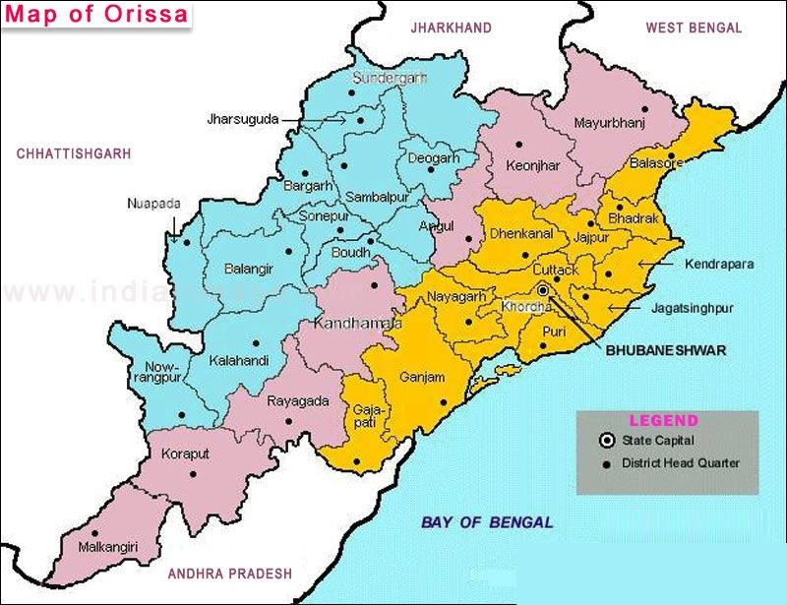
Map of Odisha
www.niir.org
www.entrepreneurindia.co

Slide 6

Economy
Expenditure for 2020-21 is estimated to be Rs 1, 50,000 crore, an 11% increase over the revised estimate of 2019-20. The revised expenditure for 2019-20 is Rs 4,000 crore (2.9%) lower than the budgeted estimate. Fiscal deficit for the year 2020-21 is targeted at Rs 17,878 crore (3% of GSDP). In 2019-20, as per the revised figures, the fiscal deficit is estimated to decrease by Rs 693 crore to 3.41% of GSDP, as compared to the budgeted estimate of 3.49% of GSDP. The budget estimates a revenue surplus of Rs 9,509 crore (1.6%) in 2020-21.
Book: - BOOKS & DATABASES
www.niir.org
www.entrepreneurindia.co

Slide 7
Odisha’s economy is consistently growing at a higher rate compared to the national growth. During the last seven years, the average growth of Odisha has remained about 8% compared to national average of about 6.9%. In spite of a slowdown in the global and national economy, Odisha’s economy is expected to grow at the rate of 6.16 per cent in 2019-20 well above all India growth rate of 5%.
With the policy of the State Government to promote industries and higher investment in the infrastructure sector along with a focus on the social sector, the State economy is estimated to grow in the range of 7% to 7.5% during 2020-21.
To increase fish productivity and production a provision of Rs.16 crore has been proposed for development of Brackish Water Aquaculture, Marine Fisheries, Intensive Aquaculture and Inland Fisheries. An allocation of Rs.60 crore has been proposed to support Farmers’ Producers Organizations (FPOs) in the field of agriculture and allied sectors, food processing, warehousing and logistics sectors.
Market Research: - Market Research Report
www.niir.org
www.entrepreneurindia.co

Slide 8
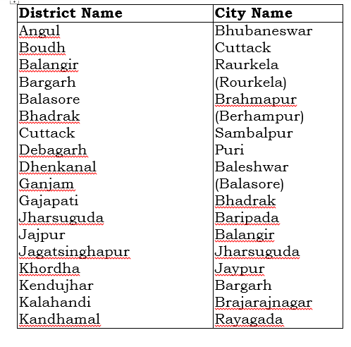
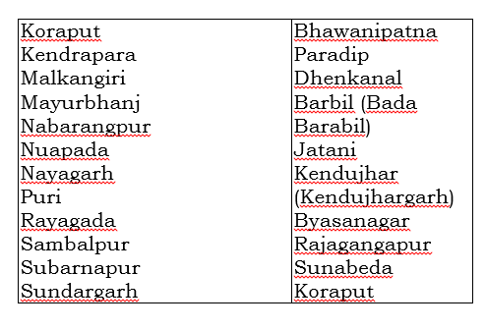
Odisha (Orissa):-
www.niir.org
www.entrepreneurindia.co

Slide 9
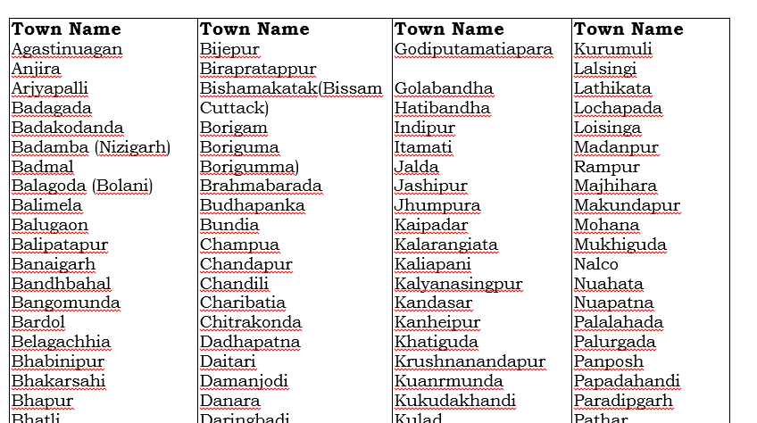
www.niir.org
www.entrepreneurindia.co

Slide 10
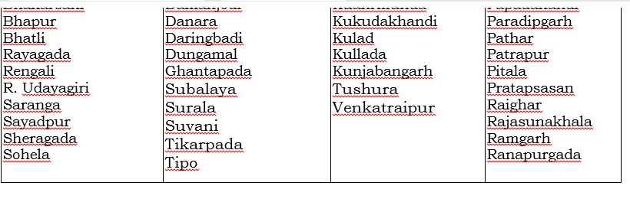

www.niir.org
www.entrepreneurindia.co

Slide 11
Ease of Doing Business
District Industrial Centers (DIC) shall act as the nodal agency for promotion of MSME in the State
Single Window Clearance & Online Combined Application Form (CAF) to facilitate time bound clearances to investment
District Level Single Window Clearance Authority shall assess & recommend the requirement of land
The DICs shall be strengthened and revitalized to eliminate the existing bottlenecks and facilitate smooth functioning to address the needs of the investors
Online disbursement of incentives mechanism shall be developed and the applicable incentives shall be disbursed in time bound manner
An online platform shall also be facilitated for the investors to lodge grievances. A team at the state level headed by the Secretary, MSME Department shall monitor all the grievances lodged, and the action taken on the grievances.
Project: - Which Business is best in Odisha (Orissa)?
www.niir.org
www.entrepreneurindia.co

Slide 12
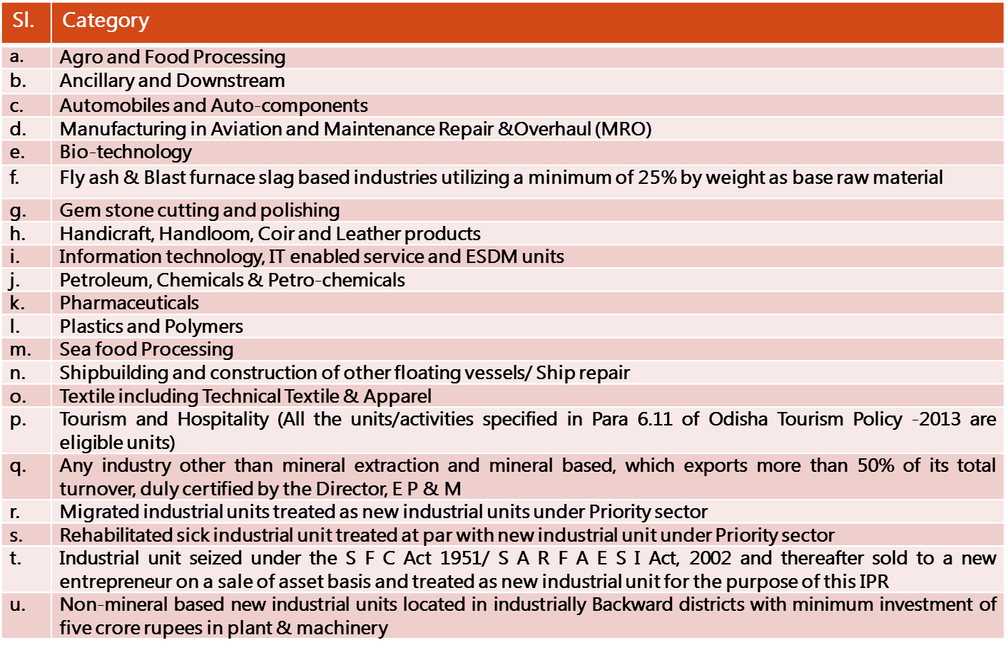
Priority Sector Means–Industrial Units Fall Within Following Categories:
www.niir.org
www.entrepreneurindia.co

Slide 13
Project Opportunities/Investment in Odisha (Orissa):-
Biodegradable Plastic Pellets • Corn Starch Thermoplastic & Polyvinyl Alcohol •pbat & Corn Starch Thermoplastic •pla + Pbat + Corn Starch Thermoplastic •pla + Pbat + Caco3
Bio-degradable Plates From Areca Nuts Tree Leaf, Barks And Bamboo
Biodegradable Disposable Cups And Plates Using Sugarcane Bagasse
Biodegradable Plastic Products (bags, Plates & Glasses)
Biogas Production
Biogas Power Plant From Cow Dung
Biomass Gasification Power Plant
Biofertilizer From Cotton Seed Cake
www.niir.org
www.entrepreneurindia.co

Slide 14
Bagasse Based Cogeneration Power Plant
Biomass Power Generation Plant
Caramel Color
Card & Gray Board from Pulp and Waste Paper
Cashew Processing
Chocolate, Toffee And Candy Industry
Cattle Feed
Cellulose Acetate
Cement Plant
Copper Melting and Copper Ingot Rolling with Copper Wire Drawing
www.niir.org
www.entrepreneurindia.co

Slide 15
Corn Flakes
Crude Rubber Processing
Caps and Closures
Centralized Metal Testing Laboratory
Combs
Chocolate
Chicken/mutton (sheep Meat) Processing
www.niir.org
www.entrepreneurindia.co

Slide 16
Cake Gel (cake Improver)
Calcium Propionate - Manufacturing Plant
Cattle Breeding & Dairy Farming To Produce Milk
Chocolate & Confectionery
Chewing Gum - Manufacturing Plant
Cold Storage (fruits & Vegetables)
Cold Storage For Potatoes & Mahua
Cake Gel (cake Improver)
Cold Storage With Ice Plant
Cold Storage
Controlled Atmosphere Cold Storage
Cold Storage (shrimp & Agricultural Products)
Co-generation Power Plant Based On Bagasse
Compressed Biogas
www.niir.org
www.entrepreneurindia.co

Slide 17
Captive Power Plant
Ciprofloxacin
Ciprofloxacin Hcl –cipro - Manufacturing Plant
Dextrose Powder
Disposable Plastic Syringes
Disposable Caps
Disposable Surgical Face Mask & N95 Masks
Disposable Nitrile Gloves (powder Free)
Dairy Farming With Power Plant Based On Dung
Dairy Farming , Milk Products With Cow Urine Processing And Biogas Plant
Egg Powder
Electronics (E-Waste, E-Scrap) Recycling Plant
Energy Bar
www.niir.org
www.entrepreneurindia.co

Slide 18
E–Waste Recycling Plant
E-waste Recycling Plant (electronic Waste, E-waste, E-scrap, Or Waste Electrical And Electronic Equipment (weee)
E-waste & Lithium Battery Recycling Plant
E-waste Recycling For Extraction Of Precious Metals (nickel, Tin & Zinc), Gold, Silver, Palladium, Plastic, Glass And Copper
Expanded Metal Mesh Manufacturing
Eco-friendly Profitable Business Ideas Of Compostable & Disposable Tableware From Rice Straw And Wheat Straw
Ethanol As Biofuel
Entertainment Club, 4 Star Hotel, Amusement Park Cum Water Park, And Lake For Boating
Food Processing Unit (Pulses & Dates)
Fabricated Aluminium Products
www.niir.org
www.entrepreneurindia.co

Slide 19
Fishing Net
Fish Dehydration
Functional Food Based Bakery Products (bread, Cookies And Biscuits)
Frozen Layer Paratha
Fresh Dips
Fruits & Vegetables Powder (tomato, Onion, Mango, Pomegranate And Papaya Powder)
Fish Flavoured Chips
Five Star Hotel, Business Centre (shopping Centre), P. V. R. , Health Club & Banquet Hall
Five Star Hotel & Business Shopping Mall
Gunny Bags
Groundnut Oil
Hard Gelatin Capsules
HDPE Woven Sacks
Holiday Resort (Three Star Grade)
www.niir.org
www.entrepreneurindia.co

Slide 20
Hand Sanitizer Manufacturing
High Fructose Corn Syrup (hfcs)
Hard Boiled Candy
Hydro Based Power Plant
Hotel
Hospital With Teaching Facility
Hospital
Hotel With Discotheque
Information Technology (IT) Park
IV (intravenous) Fluids
Iv Fluids (BSF Technology)
Integrated Unit Cold Storage With Food Processing
Jatropha Plantation & Oil Extraction (Used as Biofuel)
Khandsari Sugar
www.niir.org
www.entrepreneurindia.co

Slide 21
Ladies under Garments (Bra & Panties)
Linear Alkyl Benzene (L.A.B)
LPG Cylinders
Latex (rubber) Foam Product
Lunch Boxes
Liquid Floor Cleaners (lizol & Easy Type)
Liquid Glucose From Broken Rice
Lemon-lime Flavoured Soft Drink (Nimbu Pani)
Masala Powder
Medical College With Hospital
www.niir.org
www.entrepreneurindia.co

Slide 22
Niir Project Consultancy Services (NPCS) is a group of engineers, planners, specialists, financial experts, economic analysts, and design specialists with extensive experience in the related industries. NPCS provides various services and the books and project reports by NPCS are widely popular; many Industrialists and Entrepreneurs have taken benefit from the project reports provided by NPCS not only in India but worldwide. All the project reports cover the detailed aspect of business, from analyzing the market, confirming availability of various necessities such as Manufacturing Plant, Detailed Project Report, Profile, Business Plan, Industry Trends, Market Research, etc.
Related Project: - What is the Best Business Plan to Start in Odisha
www.niir.org
www.entrepreneurindia.co

Slide 23
Tags
#DetailedProjectReport #businessconsultant #BusinessPlan #feasibilityReport #NPCS #StartupProject #howtostartbusiness #ProjectReprot #businessplanning #potentialbusinessidea #business4you #Startupbusiness4you #StartupBusinessPlan #StartupIndiaConsultants #startupinvestment #startupbusinessidea #startup2020 #odishabusiness #odishastartupbusiness #OdishaInvestment #OdishaBusiness #OdishaStartUp #BusinessOdisha #odishabusinessindustry #investodisha #odishamarket #Odishaproject #biodegradableplasticpellets #plapellets #biodegradablepellets #biodegradableplasticgranules #ecofriendlyproducts #biodegradableproduct #CPLAandPLA #Bagasseproducts #cassavaproducts #biodegradabledisposablecups #biodegradablecup #Biodegradablebusinessplan #biodegradableplastic #BiogasProduction #BiogasProductionbusinessplan
www.niir.org
www.entrepreneurindia.co

Slide 24
#BiogasPowerPlant #BiomassGasificationPowerPlant #BiomassGasfier #Biofertilizer #biofertilizersmanufacturers #biofertilizerproduction #BagasseBasedCogenerationPowerplant #BiomassPowerGenerationPlant #CaramelColor #CaramelColorbusinessplan #CashewProcessing #CashewProcessingbusinessplan #Chocolatebusiness #Chocolatebusinessplan #CattleFeedbusinessplan #CattleFeed #CelluloseAcetate #CelluloseAcetatebusinessplan #CementPlant #CopperMelting #CopperIngotRolling #CornFlakesbusinessplan #CrudeRubberProcessing #CapsandClosures #CentralizedMetalTestingLaboratory #Combsbusinessplan #ConfectioneryProduction #Chocolatemanufacturing #Chocolatebusinessplan #ChickenmuttonProcessing
www.niir.org
www.entrepreneurindia.co

Slide 25
#CakeGel #CakeGelBusinessPlan #CalciumPropionate #calciumcarbonate #CalciumPropionateMarketResearch #CalciumPropionateMarket #CattleBreedingMarket #CattleBreedingManufacturing #DairyFarming #dairyfarmingbusiness #dairyproducts #ChocolateManufacturing #ChocolateProduction #ChocolateMarket #ChocolateIndustry #ChocolateBusinessPlan #Chocolate&Confectionery #ChewingGumMarket #ChewingGumBusinessPlan #ColdStorageMarket #ColdStorage #ColdStorageBusiness #ColdStorageIndustry #coldchainindustry #coldstoragebusinessplan #Potatoes&Mahua #ControlledAtmosphereColdStorage #CogenerationPower
#CogenerationPowerBusinessPlan #CompressedBiogas #OrganicFertilizer #CaptivePowerPlant #Ciprofloxacin #CiprofloxacinBusinessIdea #CiprofloxacinHcl #CiprofloxacinHclBusiness #CiprofloxacinHclMarket #DextrosePowderMarket
www.niir.org
www.entrepreneurindia.co

Slide 26
#DextrosePowderManufacturing #MedicalDevicesIndustry #disposablePlasticSyringes #disposablePlasticSyringesBusiness #DisposableCaps #DisposableCapsBusiness #MedicalFaceMask #MedicalMask #SurgicalMask #SurgicalFaceMask #DisposableMedicalFaceMask #DisposableMedicalMask #DisposableSurgicalMask #DisposableSurgicalFaceMask #disposablenitrilegloves #NitrileGloves #glovesBusiness #EggPowder #EggPowderBusiness #EggPowderMarket #EWasteRecyclingPlant #LithiumBatteryRecyclingPlant #ExpandedMetalMesh #Ecofriendly #EthanolAsBiofuel #EntertainmentClub #4StarHotel #FoodProcessingUnit #FabricatedAluminium #FishingNet #FishDehydration #Bakery #FrozenLayerParatha #FreshDips #FishFlavouredChips #GunnyBags #GroundnutOil #HardGelatinCapsules #HDPEWovenSacks #HolidayResort #HandSanitizer #HighFructoseCornSyrup #HardBoiledCandy #HydroBasedPower #Hotel #Hospital #HotelWithDiscotheque #InformationTechnology #IvFluids #ColdStorage #OilExtraction #KhandsariSugar #LadiesunderGarments #LinearAlkylBenzene #LPGCylinders #LunchBoxes #LiquidFloorCleaners #LiquidGlucose #BrokenRice #LemonlimeFlavouredSoftDrink #MasalaPowder #MedicalCollege
www.niir.org
www.entrepreneurindia.co

Slide 27
For more Projects and further details, visit at:
Project Reports & Profiles
BOOKS & DATABASES
Market Research Report
www.niir.org
www.entrepreneurindia.co

Slide 28
Major Queries/Questions Answered in Our Report?
1. How has the industry performed so far and how will it perform in
the coming years?
What is the Project Feasibility of the Plant?
What are the requirements of Working Capital for setting up the
plant?
4. What is the structure of the industry and who are the key/major
players?
www.niir.org
www.entrepreneurindia.co

Slide 29
5. What is the total project cost for setting up the plant?
What are the operating costs for setting up the plant?
What are the machinery and equipment requirements for setting
up the plant?
8. Who are the Suppliers and Manufacturers of Plant & Machinery for
setting up the plant?
9. What are the requirements of raw material for setting up the
plant?
www.niir.org
www.entrepreneurindia.co

Slide 30
10. Who are the Suppliers and Manufacturers of Raw materials for
setting up the plant?
11. What is the Manufacturing Process of the plant?
12. What is the total size of land required for setting up the plant?
13. What will be the income and expenditures for the plant?
14. What are the Projected Balance Sheets of the plant?
www.niir.org
www.entrepreneurindia.co

Slide 31
15. What are the requirement of utilities and overheads for setting up
the plant?
16. What is the Built up Area Requirement and cost for setting up the
plant?
17. What are the Personnel (Manpower) Requirements for setting up
the plant?
18. What are Statistics of Import & Export for the Industry?
19. What is the time required to break-even?
www.niir.org
www.entrepreneurindia.co

Slide 32
20. What is the Break-Even Analysis of the plant?
21. What are the Project financials of the plant?
22. What are the Profitability Ratios of the plant?
23. What is the Sensitivity Analysis-Price/Volume of the plant?
24. What are the Projected Pay-Back Period and IRR of the plant?
25. What is the Process Flow Sheet Diagram of the plant?
26. What are the Market Opportunities for setting up the plant?
27. What is the Market Study and Assessment for setting up the plant?
28. What is the Plant Layout for setting up the plant?
www.niir.org
www.entrepreneurindia.co

Slide 33
Reasons for Buying Our Report:
• The report helps you to identify a profitable project for investing or diversifying into by throwing light to crucial areas like industry size, market potential of the product and reasons for investing in the product
• The report provides vital information on the product like it’s characteristics and segmentation
• The report helps you market and place the product correctly by identifying the target customer group of the product
www.niir.org
www.entrepreneurindia.co

Slide 34
• The report helps you understand the viability of the project by disclosing details like machinery required, project costs and snapshot of other project financials
• The report provides a glimpse of government regulations applicable on the industry
• The report provides forecasts of key parameters which helps to anticipate the industry performance and make sound business decisions
www.niir.org
www.entrepreneurindia.co

Slide 35
Our Approach:
• Our research reports broadly cover Indian markets, present analysis, outlook and forecast for a period of five years.
• The market forecasts are developed on the basis of secondary research and are cross-validated through interactions with the industry players
• We use reliable sources of information and databases. And information from such sources is processed by us and included in the report
www.niir.org
www.entrepreneurindia.co

Slide 36
Free Instant Online Project Identification and Selection Service
Our Team has simplified the process for you by providing a "Free Instant Online Project Identification & Selection" search facility to identify projects based on multiple search parameters related to project costs namely: Plant & Machinery Cost, Total Capital Investment, Cost of the project, Rate of Return% (ROR) and Break Even Point % (BEP). You can sort the projects on the basis of mentioned pointers and identify a suitable project matching your investment requisites……Read more
www.niir.org
www.entrepreneurindia.co

Slide 37
Download Complete List of Project Reports:
Detailed Project Reports
Visit:-https://www.entrepreneurindia.co/complete-project-list
NPCS is manned by engineers, planners, specialists, financial experts, economic analysts and design specialists with extensive experience in the related industries.
Our Market Survey cum Detailed Techno Economic Feasibility Report provides an insight of market in India. The report assesses the market sizing and growth of the Industry. While expanding a current business or while venturing into new business, entrepreneurs are often faced with the dilemma of zeroing in on a suitable product/line.
www.niir.org
www.entrepreneurindia.co

Slide 38
And before diversifying/venturing into any product, they wish to study the following aspects of the identified product:
Good Present/Future Demand
Export-Import Market Potential
Raw Material & Manpower Availability
Project Costs and Payback Period
The detailed project report covers all aspect of business, from analyzing the market, confirming availability of various necessities such as Manufacturing Plant, Detailed Project Report, Profile, Business Plan, Industry Trends, Market Research, Survey, Manufacturing Process, Machinery, Raw Materials, Feasibility Study, Investment Opportunities, Cost and Revenue, Plant Economics, Production Schedule,
www.niir.org
www.entrepreneurindia.co

Slide 39
Working Capital Requirement, uses and applications, Plant Layout, Project Financials, Process Flow Sheet, Cost of Project, Projected Balance Sheets, Profitability Ratios, Break Even Analysis. The DPR (Detailed Project Report) is formulated by highly accomplished and experienced consultants and the market research and analysis are supported by a panel of experts and digitalized data bank.
We at NPCS, through our reliable expertise in the project consultancy and market research field, have demystified the situation by putting forward the emerging business opportunity in India along with its business prospects……Read more
www.niir.org
www.entrepreneurindia.co

Slide 40

Visit us at:
www.entrepreneurindia.co
www.niir.org
www.niir.org
www.entrepreneurindia.co

Slide 41
Take a look at
on #Street View
https://goo.gl/VstWkd
www.niir.org
www.entrepreneurindia.co

Slide 42
Locate us on
Google Maps
https://goo.gl/maps/BKkUtq9gevT2
www.niir.org
www.entrepreneurindia.co

Slide 43
Contact us
106-E, Kamla Nagar, Opp. Mall ST,
New Delhi-110007, India.
Email: npcs.ei@gmail.com , info@entrepreneurindia.co
Tel: +91-11-23843955, 23845654, 23845886
Mobile: +91-9097075054, 8800733955
Fax: +91-11-23841561
Website : www.entrepreneurindia.co , www.niir.org
Take a look at on #StreetView
https://goo.gl/VstWkd
www.niir.org
www.entrepreneurindia.co

Slide 44
AN ISO 9001: 2015 CERTIFIED COMPANY
www.niir.org
www.entrepreneurindia.co

Slide 45
Who are We?
One of the leading reliable names in industrial world for providing the most comprehensive technical consulting services
We adopt a systematic approach to provide the strong fundamental support needed for the effective delivery of services to our Clients’ in India & abroad
www.niir.org
www.entrepreneurindia.co

Slide 46
What do We Offer?
Project Identification
Detailed Project Reports/Pre-feasibility Reports
Business Plan
Market Research Reports
Technology Books and Directory
Industry Trend
Databases on CD-ROM
Laboratory Testing Services
Turnkey Project Consultancy/Solutions
Entrepreneur India (An Industrial Monthly Journal)
www.niir.org
www.entrepreneurindia.co

Slide 47
How are We Different ?
We have two decades long experience in project consultancy and market research field
We empower our customers with the prerequisite know-how to take sound business decisions
We help catalyze business growth by providing distinctive and profound market analysis
We serve a wide array of customers , from individual entrepreneurs to Corporations and Foreign Investors
We use authentic & reliable sources to ensure business precision
www.niir.org
www.entrepreneurindia.co

Slide 48
Our Approach
Requirement collection
Thorough analysis of the project
Economic feasibility study of the Project
Market potential survey/research
Report Compilation
www.niir.org
www.entrepreneurindia.co

Slide 49
Who do we Serve?
Public-sector Companies
Corporates
Government Undertakings
Individual Entrepreneurs
NRI’s
Foreign Investors
Non-profit Organizations, NBFC’s
Educational Institutions
Embassies & Consulates
Consultancies
Industry / trade associations
www.niir.org
www.entrepreneurindia.co

Slide 50
Sectors We Cover
Ayurvedic And Herbal Medicines, Herbal Cosmetics
Alcoholic And Non Alcoholic Beverages, Drinks
Adhesives, Industrial Adhesive, Sealants, Glues, Gum & Resin
Activated Carbon & Activated Charcoal
Aluminium And Aluminium Extrusion Profiles & Sections,
Bio-fertilizers And Biotechnology
Breakfast Snacks And Cereal Food
Bicycle Tyres & Tubes, Bicycle Parts, Bicycle Assembling
www.niir.org
www.entrepreneurindia.co

Slide 51
Sectors We Cover Cont…
Bamboo And Cane Based Projects
Building Materials And Construction Projects
Biodegradable & Bioplastic Based Projects
Chemicals (Organic And Inorganic)
Confectionery, Bakery/Baking And Other Food
Cereal Processing
Coconut And Coconut Based Products
Cold Storage For Fruits & Vegetables
Coal & Coal Byproduct
www.niir.org
www.entrepreneurindia.co

Slide 52
Sectors We Cover Cont…
Copper & Copper Based Projects
Dairy/Milk Processing
Disinfectants, Pesticides, Insecticides, Mosquito Repellents,
Electrical, Electronic And Computer based Projects
Essential Oils, Oils & Fats And Allied
Engineering Goods
Fibre Glass & Float Glass
Fast Moving Consumer Goods
Food, Bakery, Agro Processing
www.niir.org
www.entreprneurindia.co

Slide 53
Sectors We Cover Cont…
Fruits & Vegetables Processing
Ferro Alloys Based Projects
Fertilizers & Biofertilizers
Ginger & Ginger Based Projects
Herbs And Medicinal Cultivation And Jatropha (Biofuel)
Hotel & Hospitability Projects
Hospital Based Projects
Herbal Based Projects
Inks, Stationery And Export Industries
www.niir.org
www.entrepreneurindia.co

Slide 54
Sectors We Cover Cont…
Infrastructure Projects
Jute & Jute Based Products
Leather And Leather Based Projects
Leisure & Entertainment Based Projects
Livestock Farming Of Birds & Animals
Minerals And Minerals
Maize Processing(Wet Milling) & Maize Based Projects
Medical Plastics, Disposables Plastic Syringe, Blood Bags
Organic Farming, Neem Products Etc.
www.niir.org
www.entrepreneurindia.co

Slide 55
Sectors We Cover Cont…
Paints, Pigments, Varnish & Lacquer
Paper And Paper Board, Paper Recycling Projects
Printing Inks
Packaging Based Projects
Perfumes, Cosmetics And Flavours
Power Generation Based Projects & Renewable Energy Based Projects
Pharmaceuticals And Drugs
Plantations, Farming And Cultivations
Plastic Film, Plastic Waste And Plastic Compounds
Plastic, PVC, PET, HDPE, LDPE Etc.
www.niir.org
www.entrepreneurindia.co

Slide 56
Sectors We Cover Cont…
Potato And Potato Based Projects
Printing And Packaging
Real Estate, Leisure And Hospitality
Rubber And Rubber Products
Soaps And Detergents
Stationary Products
Spices And Snacks Food
Steel & Steel Products
Textile Auxiliary And Chemicals
www.niir.org
www.entrepreneurindia.co

Slide 57
Sectors We Cover Cont…
Township & Residential Complex
Textiles And Readymade Garments
Waste Management & Recycling
Wood & Wood Products
Water Industry(Packaged Drinking Water & Mineral Water)
Wire & Cable
www.niir.org
www.entrepreneurindia.co

Slide 58
www.niir.org
www.entrepreneurindia.co

Slide 59

To get a detailed scenario of the industry along with its structure and classification
To provide a comprehensive analysis of the industry by covering aspects like:
  Growth drivers of the industry
  Latest market trends
  Insights on regulatory framework
  SWOT Analysis
  Demand-Supply Situation
  Foreign Trade
  Porters 5 Forces Analysis
www.niir.org
www.entrepreneurindia.co

Slide 60
To provide forecasts of key parameters which helps to anticipate the industry performance
To help chart growth trajectory of a business by detailing the factors that affect the industry growth
To help an entrepreneur/manager in keeping abreast with the changes in the industry
To evaluate the competitive landscape of the industry by detailing:
  Key players with their market shares
  Financial comparison of present players
www.niir.org
www.entrepreneurindia.co

Slide 61

Venturist/Capitalists
Entrepreneur/Companies
Industry Researchers
Investment Funds
Foreign Investors, NRI’s
Project Consultants/Chartered Accountants
Banks
Corporates
Click here for list
www.niir.org
www.entrepreneurindia.co

Slide 62


_{Secondary}
Online Research
^{Research}
Industry Journals
Surveys
One-on-one
Interactions
Databases
Primary
Research
Industry Experts
Industry Industry
Sources Associations
Companies
www.niir.org
www.entrepreneurindia.co

Slide 63







Present Status
(Indian & Global)
Outlook & Forecasts
(5Years)
Macro Environment
Indian Market
Demand Assessment
Internal Market
Analysis
SWOT & Porters
Analysis
www.niir.org
www.entrepreneurindia.co

Slide 64

  Our research team comprises of experts from various financial fields:
  MBA’s
  Industry Researchers
  Financial Planners
  Research veterans with decades of experience
www.niir.org
www.entrepreneurindia.co

Slide 65
1. Overview
2. Market Analysis
  2.1Growth Drivers
  2.2Emerging Trends in the Industry
  2.3Regulatory Framework
  2.4SWOT Analysis
  2.5Herfindahl–Hirschman Index (HHI)
3. Market Forecasts
4. Key Players
www.niir.org
www.entrepreneurindia.co

Slide 66
  5. Key Financials and Analysis
  5.1 Contact Information
  5.2 Key Financials
  5.3 Financial comparison
  6. Industry Size & Outlook
www.niir.org
www.entrepreneurindia.co

Slide 67
Contact us
106-E, Kamla Nagar, Opp. Mall ST,
New Delhi-110007, India.
Email: npcs.ei@gmail.com , info@entrepreneurindia.co
Tel: +91-11-23843955, 23845654, 23845886
Mobile: +91-9097075054, 8800733955
Website : www.entrepreneurindia.co , www.niir.org
Take a look at on #StreetView
https://goo.gl/VstWkd
www.niir.org
www.entrepreneurindia.co

Slide 68





Follow Us
https://www.linkedin.com/company/niir-project-consultancy-services
https://www.facebook.com/NIIR.ORG
https://www.youtube.com/user/NIIRproject
https://twitter.com/npcs_in
https://www.pinterest.com/npcsindia/
www.niir.org
www.entrepreneurindia.co

Slide 69

For more information, visit us at: www.entrepreneurindia.co www.niir.org
www.entrepreneurindia.co

